Slide 1

Store Sales: Analyzing and predicting
Abdulrahman AL-SALLUM

Slide 2
The Data
Data Cleaning and visualization
Modelling
Content

Slide 3
The Data
Data Cleaning and visualization
Modelling
Content

Slide 4
What is the Data we are working with ? And what are trying to do?
The data is from the Big Mart stores, it was collected in 2013 which shows the sales of different products from different outlets. The Goal is to have better understanding of the data and what outlets perform better than others. After this we can have a model to predict the sales for the upcoming year .
Features of the data :
ProductID : unique product ID
Weight : weight of products
FatContent : specifies whether the product is low on fat or not
Visibility : percentage of total display area of all products in a store allocated to the particular product
ProductType : the category to which the product belongs
OutletID : unique store ID
EstablishmentYear : year of establishment of the outlets
OutletSize : the size of the store in terms of ground area covered
LocationType : the type of city in which the store is located
OutletType : specifies whether the outlet is just a grocery store or some sort of supermarket
OutletSales : (target variable) sales of the product in the particular store

Slide 5
The Data
Data Cleaning and visualization
Modelling
Content

Slide 6
Data Cleaning
Missing Values
The data columns were in a good shape and consistent. But there are many missing data in two columns (Product Weight and Outlet Size) around 2500 missing values.
Approaches to deal with missing values
Here we have two data types to deal with:
Product Weight which is numerical.
Outlet size which is categorical (small – medium – large)
For the numerical data (product weight) we linked all the products with their ID using a python dictionary, so any missing product weight we can find its weight from the dictionary.
For the categorical data (Outlet size) we used the mode (most occurred value) to fill the missing values.

Slide 7
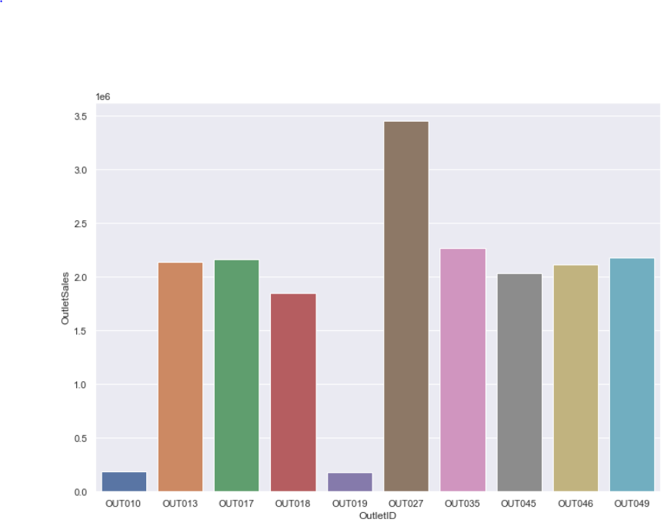
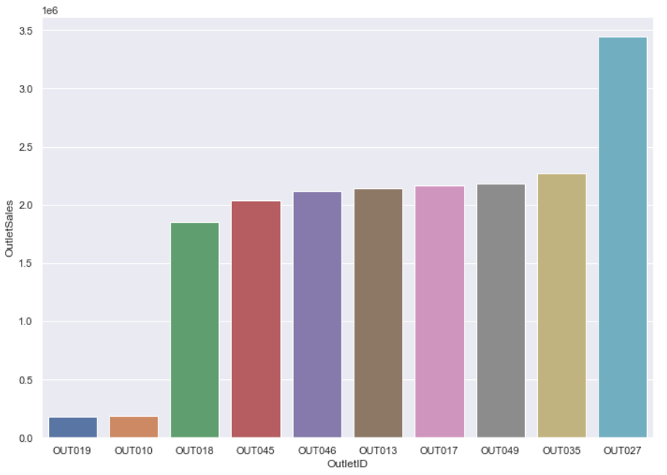
Data Visualization
What Outlet was the best in sales?
MVP
Final

Slide 8
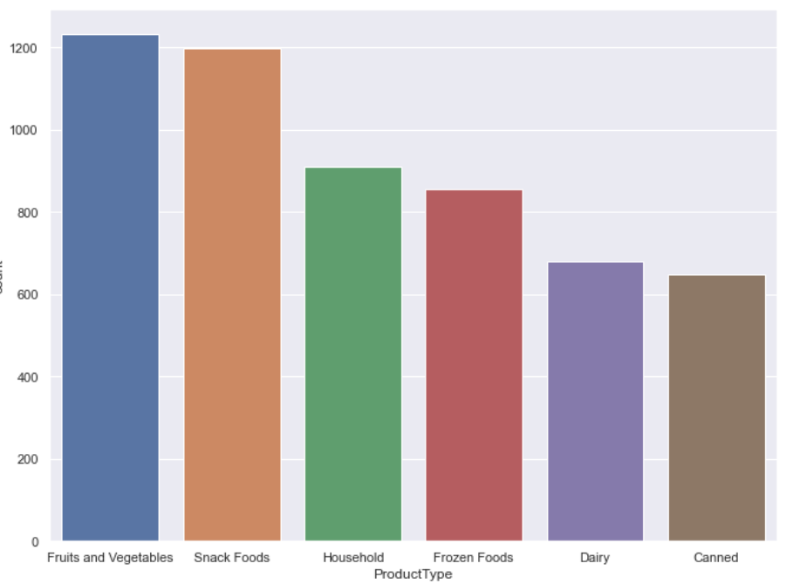
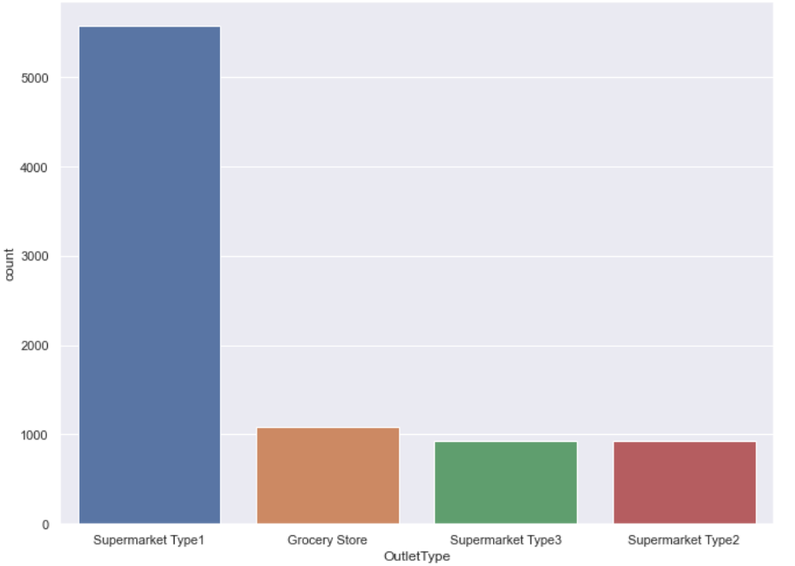
Data Visualization
Which type of products sold the most ?
Which Outlet sold the most ?

Slide 9
The Data
Data Cleaning and visualization
Modelling
Content

Slide 10
Modelling
What has been done :
Drop unneeded column such is Product ID and outlet ID
convert all categorical columns to dummies
Define X (the data without the target) and Y(the Target)
Scale X
Use Cross validation to evaluate the models.
Model | R^2
Lasso | 0.55
Ridge | 0.52
XG Regressor | 0.558
Random Forest | 0.54

Slide 11
Thank You

